Slide 1

Lecture 01: Introductions

Slide 2
Professor Robert Moseley
Assistant Professor, Engineering & Computer Science
CBU, Gordon and Jill Bourns College of Engineering
Office: TEGR 333
Office Hours:
MW 10:30 AM – 12:00 AM, 1:00 PM – 3:00 PM, ; (or by appointment)
Office Phone: (951) 552-8851
Email: rmoseley@calbaptist.edu
See http://www.calbaptist.edu/faculty-directory

Slide 3

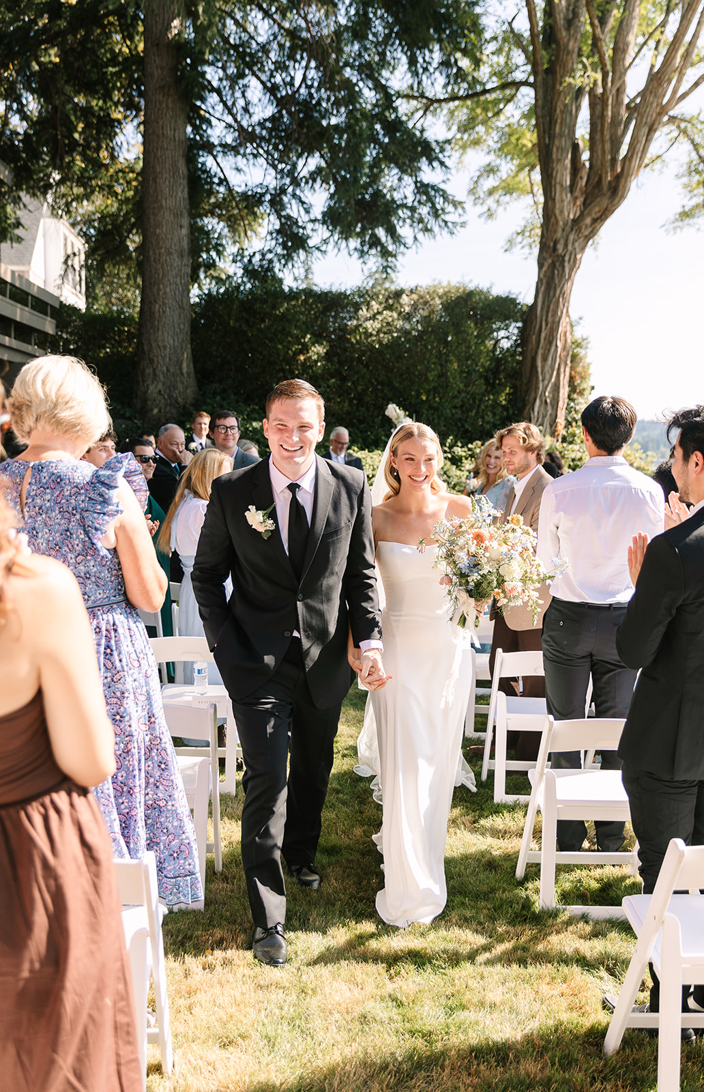

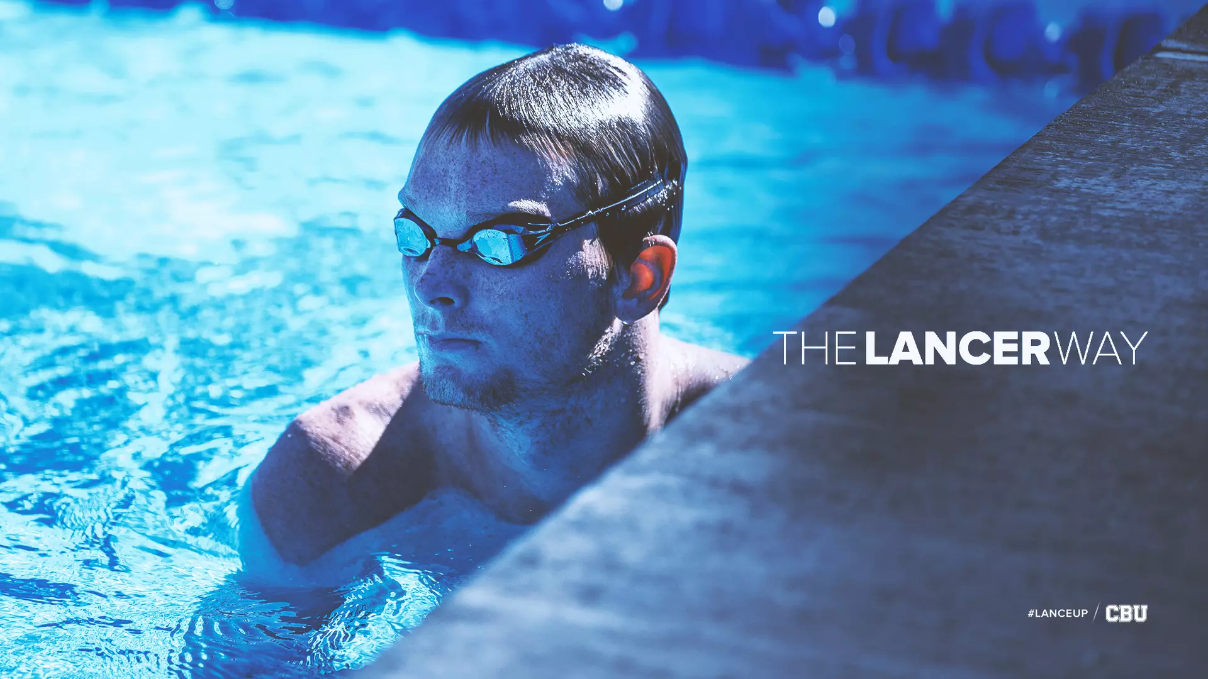

My experience
Graduated from CBU with BS + MS (computer science, engineering)
Swam at CBU for 5 years
Interned at Garner Holt, Northrop Grumman, Microsoft
Did ML work with Blink by Globe Biomedical (Dr. Rickard’s company)
Spent the last two years working as a SWE at Microsoft on AI products
Now doing PhD at UCR on multimodal machine learning
(Just got married ~3 weeks ago)

Slide 4
Your Turn
Name (preferred please)
Why AI?
What is your opinion of AI?
What do you want to do after you graduate?

Slide 5
Let’s talk about the final…

Slide 6
You have two (2) options in this class:
Track 1
You complete a small midterm project, and a bit of a bigger final project
This is what is in the syllabus
It is more of a traditional approach
It is easier

Slide 7
Or….

Slide 8
Track 2
You only complete 1(!) project in this course
You solve a difficult problem using AI
The project is much more in-depth
This will be harder (and I have higher expectations)
You have an impressive project at the end of the course (or a paper you can publish if that is what you decide)
Everyone does a comprehensive write-up in place of the midterm points
YOU decide what you work on and what you learn

Slide 9
What’s the catch?
No catch – this is a “choose your own adventure”
Track 1 is still challenging
If you choose Track 2, the points you would’ve received for your midterm will be absorbed into a new rubric for the larger final project
You need to let me know what you would like to do by the end of next week (09/12) at the latest

Slide 10
Track 1 Example Projects
Midterm:
Goal: Use basic ML techniques on an existing dataset. Scope: Data exploration, feature engineering, shallow ML (logistic regression, decision trees, kNN, SVMs).
Predictive Analytics: Use Kaggle’s Titanic dataset → predict survival with logistic regression & decision trees.
Image Classification (shallow ML): Use scikit-learn + MNIST digits, compare PCA+SVM vs. kNN.
Text Sentiment: IMDb reviews with bag-of-words + Naive Bayes.
Health Data: Predict diabetes using UCI dataset with Random Forests vs Logistic Regression.
Sports Analytics: Predict NBA/MLB game outcomes using historical data and regression/classification.
These are quick wins with public datasets and clear evaluation metrics.

Slide 11
Track 1 Example Projects
Final Project (5 weeks, medium)
Goal: Use deep learning, advanced ML, etc. Scope: Modest novelty, more effort in modeling, tuning, and storytelling.
Image Classification with CNNs: Build a small convolutional model for CIFAR-10 or custom dataset (e.g., classify traffic signs).
Transfer Learning: Fine-tune ResNet/VGG for a specialized dataset (e.g., X-ray classification, flower species).
Sequence Modeling: LSTM for stock price trends or weather forecasting.
Natural Language: Train a small text classifier with BERT (Hugging Face). Compare with logistic regression baseline.
Reinforcement Learning: Use OpenAI Gym (CartPole, MountainCar). Students can extend with custom reward shaping.
Generative Models: Build a simple GAN for MNIST or Fashion-MNIST (generate digits/shoes).
Domain Applications:
Medical: classify chest X-rays (with Kaggle dataset).
Social Media: detect hate speech with transformer fine-tuning.
Finance: fraud detection using imbalanced dataset handling.

Slide 12
Track 2 Example Projects
Goal: Tackle a bigger, semi-open problem — exploratory, with either a research bent or applied AI innovation. Scope: Students show initiative: design their dataset pipeline, tackle harder tasks, and/or propose an AI-for-X project. Examples:
Unsolved / Open-Ended Problems (student-friendly scale):
RL Exploration: Train an RL agent to play a simple new game or adapt an environment (custom grid world).
Bias & Fairness Study: Analyze bias in a dataset (e.g., COMPAS, recidivism predictions) with multiple models.
Energy Forecasting: Predict energy demand using temporal models + deep learning.
Climate/Enviro AI: Use satellite imagery to classify land use or track deforestation with CNNs.
Multi-modal Learning: Combine text + images (e.g., fake news detection with news text + headline images).
Human-in-the-Loop: Build a small system where human feedback improves model predictions (toy RLHF).
Applied AI to another field:
Biology: Classify satellite imagery to track coral reef bleaching or deforestation over time..
Sports: predict swimming race outcomes based on training/physiology data.
Education: design a quiz-recommendation system using student performance logs.
Business: customer churn prediction with imbalanced classification methods.
Research-adjacent explorations:
Compare transformer vs RNN on small NLP tasks.
Benchmark shallow ML vs DL on structured tabular datasets (classic pain point in industry).
Experiment with active learning (label efficiency).

Slide 13
What’s the point?
Well… to allow you to learn and study things that are interesting to you. My only job in this course is to enable you to do cool things.
Track 1
Midterm: Get your hands dirty with a dataset. Apply what you’ve learned in class with shallow models.
Final (Medium): Go deeper — use deep learning, transfer learning, or tackle a more complex dataset/problem.
Track 2
Semester-long: Tackle a big idea — explore an unsolved or applied AI problem. Show curiosity, not perfection. Depth and initiative matter more than results.

Slide 14
Timeline (these are approximations only)
End of week 2 everyone has decided what track they will be choosing for this course
End of week 3:
Track 1 begins brainstorming for midterm
Track 2 submits a full project proposal
Week 6:
Track 1 midterm project is due
Track 2 in-depth project update due
Week 10
Track 1 begins work on final project
Week 12-14
Track 1 & Track 2 wrap up final projects
All groups present their research
Track 2 submits final project report

Slide 15
How it impacts grading
Track 1
Grading
Participation (Presentations / zyBooks Participation/Challenge Activities) | 10%
Homework (zyLabs / Blackboard-based labs) | 10%
Coding Assignments | 30%
Project I (Midterm) | 10%
Project II (Final) | 30%
Research Presentation | 10%
Track 2
Grading
Participation (Presentations / zyBooks Participation/Challenge Activities) | 10%
Homework (zyLabs / Blackboard-based labs) | 10%
Coding Assignments | 30%
Final Paper / Report | 10%
Final Project | 30%
Research Presentation | 10%

Slide 16
Questions?

